Slide 1
Book Study: Teach Like A Champion 2.0 Chapter 3 – Setting High Academic Expectations
By: Shane Hubbard

Slide 2
What Are High Expectations?
High Expectations are not easily defined.
High expectations are very subjective.
High expectations are extremely necessary for student success.
We always hear about having high expectations for students, but we are rarely shown what that actually looks like in a classroom setting.

Slide 3
Setting High Academic Expectations
Techniques
11: No Opt Out
12: Right is Right
13: Stretch It
14: Format Matters
15: Without Apology

Slide 4
11: No Opt Out
Maintaining the expectation that it’s not okay not to try
Addresses the student who is using ‘I don’t know’ as an excuse to be left alone
Addresses the student who is honestly trying to get the answer but doesn’t know it

Slide 5
The Key Idea to No Opt Out
A sequence that begins with a student unable to anwer the question should end with the student answering that question as often as possible.

Slide 6
What it Looks Like - 4 Ways to Do It
You provide the answer; the student repeats the answer.
Another student provides the answer; the initial student repeats the answer.
You provide a cue; your student uses it to find the answer.
Another student provides a cue; the intial student uses it to find the answer.

Slide 7
Video – No Opt Out
Play Clip 1
Discussion Questions

Slide 8
12: Right is Right
Set and defend a high standard of correctness in your classroom.
Student’s answers should be 100% right before you tell him/her it is right.
In doing this you set the expectation that the questions you ask and their answers truly matter.

Slide 9
The Key Idea to Right is Right
Set and defend a high standard of correctness in your classroom.

Slide 10
4 Ways to do Right is Right
Hold out for all the way: make sure students completely answer the question correctly.
Answer the Question: make sure students are answering the actual question you asked.
Right Answer, Right Time: make sure students are not jumping ahead of your questions.
Use Technical Vocabulary: make sure students use technical vocabulary in thier answers.

Slide 11
Video – Right is Right
Play Clips 2 and 3
Discussion Questions

Slide 12
13: Stretch It
The sequence of learning does not end with a right answer; reward right answers with follow-up questions that extend knowledge and test for reliability.

Slide 13
The Key Idea to Stretch It
A sequence of learning does not end with the right answer; reward right answers with follow-up questions that extend knowledge ans test for reliability. This technique is especially important for differentiating instruction.

Slide 14
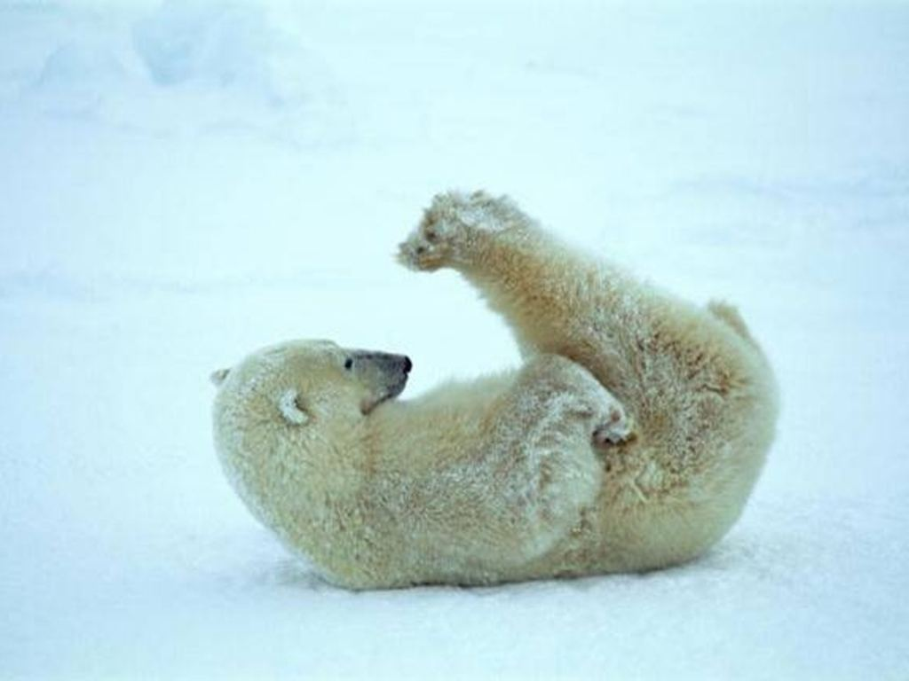
How to “Stretch It”
Ask how or why
Ask for another way to answer
Ask for a better word
Ask for evidence
Ask students to integrate a related skill
Ask students to apply the same skill in a new setting

Slide 15
Video – Stretch It
Play Clip 4
Discussion Questions

Slide 16
14: Format Matters
Use Format Matters to prepare your students to succeed by requiring complete sentences and proficient grammar every chance you get.
Grammatical Format: correct slang, syntax usage, and grammar
Complete Sentence Format: students must use complete sentences
Audible Format: make sure everyone can hear it. Use the term ‘‘VOICE’’ to ask students to speak up.

Slide 17
The Key Idea to Format Matters
It’s not just what students say that matters, but how they communicate it. To succeed, students must take their knowledge and express it in the language of opportunity.

Slide 18
Video – Stretch It
Play Clip 5
Discussion Questions

Slide 19
15: Without Apology
Assuming something is boring: if you say it’s boring it will be
Blaming it: when you blame someone else, the students won’t respond to it
Making it “accessible”: find a way to make challenging content seem attainable

Slide 20
The Key Idea to Without Apology
There is no such thing as boring content. Never apologize for what you teach.

Slide 21
Mark Your Calendars
Wednesday, November 9th @2:30pm – BTSP Meeting
Tuesday, November 29th @2:30pm – BTSP Meeting
Next Assignment – Chapter 1 – Due – Monday, November 7th by Midnight on Canvas

