Slide 1
Helping ELLs Become Academic Language
Learners

Slide 2
Helping ELLs Become Academic Language
Learners
Complex Text
Talk Moves
Common Core State Standards
Academic Language Development
Instructional Shifts
Paradigm Shift for ELLs

Slide 3
Helping ELLs Become Academic Language
Learners
Complex Text
Talk Moves
Common Core State Standards
Academic Language Development
Instructional Shifts
Paradigm Shift for ELLs

Slide 4
Helping ELLs Become Academic Language
Learners
Complex Text
Talk Moves
Common Core State Standards
Academic Language Development
Instructional Shifts
Paradigm Shift for ELLs

Slide 5
Helping ELLs Become Academic Language
Learners
Complex Text
Talk Moves
Common Core State Standards
Academic Language Development
Instructional Shifts
Paradigm Shift for ELLs

Slide 6
Helping ELLs Become Academic Language
Learners
Complex Text
Talk Moves
Common Core State Standards
Academic Language Development
Instructional Shifts
Paradigm Shift for ELLs

Slide 7
Helping ELLs Become Academic Language
Learners
Complex Text
Talk Moves
Common Core State Standards
Academic Language Development
Instructional Shifts
Paradigm Shift for ELLs

Slide 8


Instructional Shift #1
Building knowledge through content-rich nonfiction and informational texts
Notes:
Much of our knowledge base comes from informational text
Informational text makes up vast majority of required reading in college/workplace (80%)
Informational text harder for students to comprehend than narrative text
Yet students are asked to read very little of it in elementary (7 - 15%) and middle school
CCSS moves percentages to
50:50 at elementary level
75:25 at secondary level (includes ELA, science, social studies)

Slide 9

Instructional Shift #2
Reading, writing, and speaking grounded in evidence from the text, both literary and informational
Notes:
Most college and workplace writing is evidence-based and expository in nature (not narrative)
Ability to cite evidence differentiates student performance on NAEP (National Assessment of Educational Progress)
Standards in writing ask students to respond to evidence-based writing prompts (inform/argue)
Standards in speaking and listening require students to prepare for and refer to evidence on ideas under discussion
Standards in reading require students to respond to
text-dependent questions with evidence-based claims

Slide 10
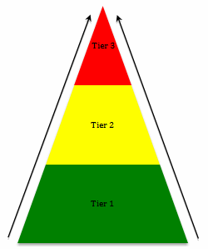
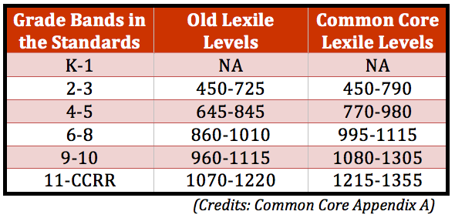
Instructional Shift #3
Regular Practice with complex text and its academic vocabulary
Notes:
Gap between complexity of college and high school texts is huge
What students can read, in terms of complexity is greatest predictor of success in college (ACT study)
Too many students reading at too low a level
(<50% of graduates can read sufficiently complex texts)
Standards include a staircase of increasing text complexity from elementary through high school
Standards also focus on building vocabulary that is shared across many types of complex texts and many content areas

Slide 11
So what is the Paradigm Shift for ELLs?
Expectations
Exposure
Interaction
Complex Texts
Paradigm Shift
Notes:
The Paradigm Shift for ELLs involves having higher expectations for our students. We need to expose them to complex text and not just expose it to them but believe that they can work with it and be successful.
We need to believe that they can interact with the text and interact with each other to understand the text.
If we don’t believe they can do it, how can we expect them to believe?
We can do this by supporting their development of language through literacy and by using differentiated approaches to help them struggle with the complex text and interact with it. And they will be successful!

Slide 12
Complex Texts
Common Core and ELLs
  CCSS adopted by many states
  Addresses the “dumbing down” of curricula
  Prepares students to be “college and career ready”
  After many years of scripted curricula, how to change teaching?
What about ELLs? Can they participate? How?
(Based on the work of Lily Wong Fillmore and Charles Fillmore)
Notes:
So where are we in relation to Complex Text and the Common Core, and where do our ELLs fit in?
This is a big question for educators considering instructional shifts and increased rigor required by the Common Core. Can ELLs and others handle more demanding, complex materials? Can we expect this of our ELLs?
According to the work and research being done in the field right now with Lily Wong Fillmore and the Council of the Great City Schools, greater text complexity and more demanding curricula is just what everyone needs to make any academic program at all. However, it all depends on us giving them what they need—exposing them to it and helping them interact with it.

Slide 13
What have been the teaching practices for ELLs?
Simplification of the L2 learning process
  Comprehension is all that matters
  Students should feel no anxiety in learning
  Scaffolding means “front-loading” all information
  Use of simplified texts which were created for struggling readers, not ELLs
  Students have had no exposure to other, more formal registers of language (oral and written)
(Based on the work of Lily Wong Fillmore and Charles Fillmore)
Notes:
So let’s take a look at what we’ve been doing.

Slide 14
The Result for ELLs
Too many years in segregated ESL classes (Valdés, 2001)
ESL classes focused on the newly arrived
No real curriculum for ELLs (scope and sequence)
Little progress in the register needed for school
Long-term ELLs! (Menken & Kleyn, 2010)
Notes:
And what has been the result???

Slide 15
Let’s look at an example of a simplified text.
Abraham Lincoln’s childhood
Abe had to work and did not get to go to school very often. But he loved to read books and would read whenever he got the chance. Math was also a favorite subject for Abe.

Slide 16
Now let’s compare to one that is a bit more complex.
Abraham Lincoln’s childhood
Lincoln had less than a year of schooling. Books were scarce and so was paper. He worked his arithmetic problems on a board and cleaned the board with a knife so he could use it again.
The family owned a Bible and he spent many hours reading it. He would copy parts of it in order to memorize it. Sometimes he would walk for miles to borrow a book. One of his favorite books was “The Life of George Washington.”

Slide 17
What’s the difference?
Abe had to work and did not get to go to school very often. But he loved to read books and would read whenever he got the chance. Math was also a favorite subject for Abe.
Lincoln had less than a year of schooling. Books were scarce and so was paper. He worked his arithmetic problems on a board and cleaned the board with a knife so he could use it again.
The family owned a Bible and he spent many hours reading it. He would copy parts of it in order to memorize it. Sometimes he would walk for miles to borrow a book. One of his favorite books was “The Life of George Washington.”
Notes:
--Using the simplified version will leave the students without a chance to get better at working with complex text.
--Many teachers who use the complex text simply tell the students the meaning which is not helping the students in the long run.
What do you see when you compare the two versions?

Slide 18
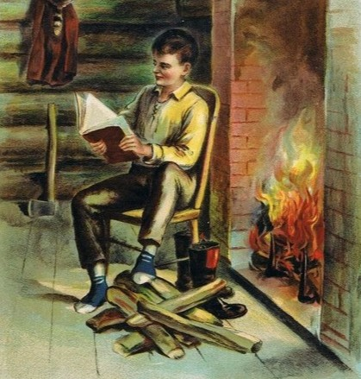
Let’s compare the two versions
Language (words, structure)
Flow, cohesiveness, coherence
Ease of following ideas
Depth of Information
Overall impression of Lincoln

Slide 19
What is needed for L2 learning?
Speakers willing to engage with learners
Learners needing or wanting the L2
A context which allows for engagement between the two.
Sufficient language data for the learner to create hypotheses about how the language works
Sufficient opportunities to use the language
Sufficient feedback to ‘correct’ hypotheses
Ever increasing complexity and breadth of data
(Wong Fillmore,1991; Gass, 1997; Swain, 2000, Gibbons, 2003)
Notes:
ELL students need to be talking, and more specifically not talked to or talked at. There should be opportunities to use the language in the classroom and receive feedback. Teachers should ask students “how does this work in English?”

Slide 20
And how are academic registers learned?
Through engagement with academic texts that are sufficiently complex
From different subject areas
And that increase in complexity
With the assistance of a teacher who can point out the structures, components, ways of expressing meaning in those texts.
(Based on the work of Lily Wong Fillmore, Charles Fillmore, Snow, Schleppegrell, Gee)
Notes:
Here are the implications for a teacher expert who knows about language.

Slide 21
Let’s return to the second text
Lincoln had less than a year of schooling. Books were scarce and so was paper. He worked his arithmetic problems on a board and cleaned the board with a knife so (that) he could use it again.
www.garden of praise.com/ibdiinco.htm
Notes:
This involves paying close attention to what is in the and what might trip people up. Look at structures of language. A close analysis of text for the teacher to help students pay attention to it. Analyze text in terms of it’s language and grammatical components. Color code text, underline.

Slide 22
Simple steps in working through a complex sentence
1. Choose a complex sentence ahead of time;
2. Decide on chunks; note complex parts.
3. In class: Read sentence aloud (together).
4. Identify the meaning of the subject.
5. Identify the meaning of the predicate.
Keep building common ground…
6. Discuss the meaning of each chunk;
Keep building common ground…
7. Keep going until the entire sentence is generally understood.
8. Ask for reformulations, paraphrases, what was learned.
9. Link paraphrases to original sentence.
10. Read the sentence aloud again, together and have someone say what it means.

Slide 23

So now you have gotten a taste…
Of a multilayered process developed by Lily Wong Fillmore and Charles Fillmore
The “Juicy Sentence”
Notes:
Dr. Fillmore has been working with K-12 educators in NY, CO, OR, NM and CA to develop the “Juicy Sentence” approach and methods around complex text.
Juicy text carries the weight or the theme.
Juicy text is where meaning resides.
Juicy text has tier 2 words, long embedded sentences & figurative language but most important is that it is connected to a big idea.

Slide 24
Talk Moves
Even if you understand how to break up complex sentences and work with them, you still have to contend with what students will say while trying to lead them in productive discussions!
Notes:
The last segment will focus on Talk Moves. It is also known as Accountable Talk, Sentence Talk, Deliberative Discourse, etc.
This may be a paradigm shift for teachers as they reflect and consider the way they interact with their students and ask them questions and ask them to discuss things in their classes.
It will seem like…oh I know this already…I’ve been teaching for 25 years…but try to be open and really think about this. It can apply to any ESL or Content Teacher.
You can refer to the Goals for Productive Discussions and the Talk Moves Map as we go through the next few slides.

Slide 25
Goals for Productive Classroom Talk
Goal 4. Help students to work with the reasoning of other students.
Goal 3. Help students to work on deepening their own reasoning.
Goal 2. Help students to orient to others and listen to what others say.
Goal 1. Help individual students to share their reasoning so that it can be heard and understood.
Notes:
Here are the four goals for Productive Discussion that are on your handout. This comes from The Inquiry Project, a science project involving Catherine O’Connor from Boston University. She and her group are also involved with the Council of the Great City Schools.
If only one or two students can do this, you don’t have a discussion, you have a monologue or a dialogue.
2. Your ultimate goal involves sharing ideas, agreements and disagreements, arguments and counter-arguments, not simply a series of students giving their own, unconnected opinions.
3. Good discussion keeps a focus on reasoning. The teacher must scaffold this consistently, getting students to dig deeper.
4. Real discussion involves students actually taking up the ideas of other students, responding to them and working with them.

Slide 26

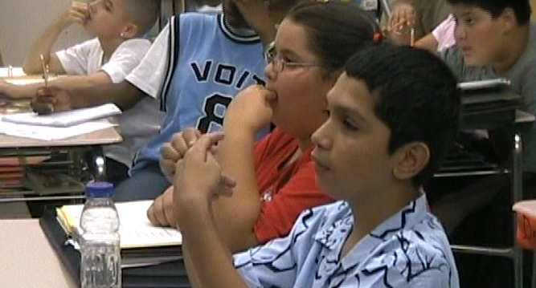
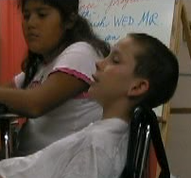
So why do you think Abraham Lincoln would walk for miles to borrow a book?
What if the response is this:
24 blank faces. 1 or 2 hands up.
Notes:
Ok, let’s say the students have read the complex text about Abraham Lincoln, and you want to engage them in a class discussion. It goes something like this…

Slide 27

You think:
They need time to think! (and maybe time to practice what they want to say!)

Slide 28
9 Talk Moves—
Choices, Choices, Choices
1. Turn and Talk
2. Say More
3. So Are You Saying?
4. Who can rephrase…?
5. Why do you think that?
Can you think of an opposite answer?
What do others think?
Who can add more to what ____ just said?
9. Who can explain why ____ said that answer?

Slide 29
Abe Lincoln had less than a year of school, so why do you think some people would say that Abe Lincoln was a good student? Who has an idea?
What if the response is this:
Bill: Well, the thing is, there’s no… books… like… yeah.

Slide 30

You think:
Huh?? I didn’t understand that at all!

Slide 31
Now what do I do? I don’t want to embarrass him, and I don’t want to feel like I’m putting him on the spot…

Slide 32
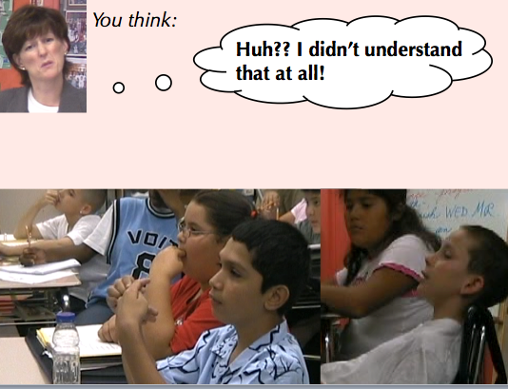
Useful talk tool:
“Say more…”
Can you say more about that?
Could you say that again?
Could you give us an example?
So let me see if I understand what you’re saying. Are you saying…?

Slide 33
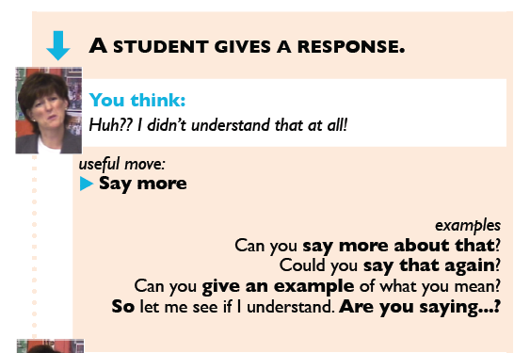
A closer look at one talk move…
Notes:
The Talk Moves Map gives samples of what a teacher might say after a student gives a response.
The left column gives talk moves that support the four goals for productive discussions.
The right column gives talk moves that the teacher can use to engage students in real world class situations which are not always perfect or “textbook”.
These talk moves will let the students know that the teacher really cares what the student responses are and requires the students to be accountable individually and as a whole class.
There are videos of the talk moves that are available online that you may want to share with others or use for professional development at your school. The sources will be listed at the end.

Slide 34
How can all of this be applied in the classroom?
Complex Text
Talk Moves
Paradigm Shift for ELLs
Common Core State Standards
Academic Language Development
Instructional Shifts

Slide 35
Instructional Shift Card
Common core Shifts for ELA/Literacy
1. Building knowledge through content-rich nonfiction
2. Reading, writing and speaking grounded in evidence from the text, both literary and informational
3. Regular practice with complex text and its academic language
More on the shifts at achievethecore.org

Slide 36
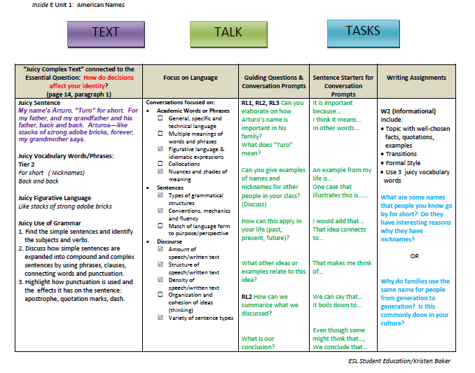
Practical Application: TEXT, TALK, TASKS
Notes:
So how can you put it all together?

Slide 38

Find powerful, beautifully written texts that build on big, curricular themes
Juicy Complex Text
Conversations that Focus on Language
Dive into & struggle with One Juicy Sentence EVERYDAY!

Slide 39
Academic Words or Phrases
My name’s Arturo, “Turo” for short. For my father, and my grandfather and his father, back and back. Arturos—like stacks of strong bricks, forever, my grandmother says.
Notes:
So the way to restart stalled language learning in Long Term ELs is by helping them discover how language works in complex texts.
We do this by getting them to notice how meaning relates to various forms and structures in the texts the students are working on and getting them to talk about their observations.

Slide 40
Sentences & Discourse
(Juicy Use of Grammar)
My name’s Arturo, “Turo” for short. For my father, and my grandfather and his father, back and back. Arturos—like stacks of strong bricks, forever, my grandmother says.
Notes:
Teachers need to know what makes a text complex:
Information density
Use of passive voice
How time, place and manner can be inserted
Uses of metaphoric phrasing
How texts cohere/hang together with phrases and clauses
They need to examine complex text closely.
--by themselves
--with guidance through the process
--in pairs or groups so different eyes catch different aspects
--by disagreeing and having to defend their choices so they come to understand better

Slide 42



Talk & Tasks
Guiding Questions & Conversation Prompts
Sentence Starters for Conversation Prompts
Writing Assignments
Initiation Response Evaluation
Notes:
Remember the Instructional Shifts and apply them to your guiding questions and writing assignments.
The last sheet of the handout gives more sentence starter samples and resources for more.

Slide 43
Time to THINK, TALK, & EVALUATE
Using your Instructional Shift Cards, look at the Writing Assignments on the TEXT, TALK, TASKS sheets and evaluate how well they follow the new instructional shifts of the Common Core.
Make recommendations with your table partners for how to improve the writing tasks.

Slide 44
Online Resources
Butterfly Video: Classroom Example of Teaching Complex Text
http://www.commoncoreworks.org/domain/111
Common Core Instructional Shifts
http://www.commoncoreworks.org/domain/108
Complex Text PD Modules (Teacher Development Series)
www.textproject.org
Talk Moves Videos by Catherine O’Connor
www.wordgeneration.org/move2.html

Slide 45
Thank you!
Kristen.baker@cms.k12.nc.us
William.king@cms.k12.nc.us

