Slide 1
The Pedagogical Shifts and a Look Inside The Classrooms

Slide 2
Objectives
To examine the six pedagogical shifts and how they impact classroom instruction
To review the “Anchor Standards”
Practice citing textual evidence to support analysis
Extend understanding of text triangulation and text sets

Slide 3
Agenda
Welcome
Introduction: A shift from the old standards to the new CCSS
What are the six pedagogical shifts in the CCSS?
What do the six pedagogical shifts look like in our classrooms?

Slide 4
Push for the CCSS
of U.S. high school students are unable to read and comprehend complex, academic materials, think critically about texts, synthesize information from multiple sources, or communicate clearly what they have learned. (taken Reading for Understanding)

Slide 5
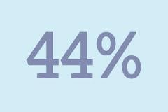
Push for the CCSS
In the United States, of high school graduates enroll in community college, either as a gateway to further education or with the goal of earning an associate degree or technical license.
to of these entering
students are placed in remedial, or developmental, English language arts or mathematics classes, or both (taken Reading for Understanding)

Slide 6
Video: CCSS
http://vimeo.com/51933492
Notes:
Do a turn and talk here. How would we summarize the CCSS for our discipline?

Slide 7
Purpose of the CCSS
To ensure students are prepared for today’s entry-level careers, freshman-level college courses, and workforce training programs.
To focus on developing the critical-thinking, problem-solving, and analytical skills students will need to be successful.
(Taken from http://www.corestandards.org)

Slide 8
In the CCSS, we all have something in common
R1/R10
Power Standards

Slide 9
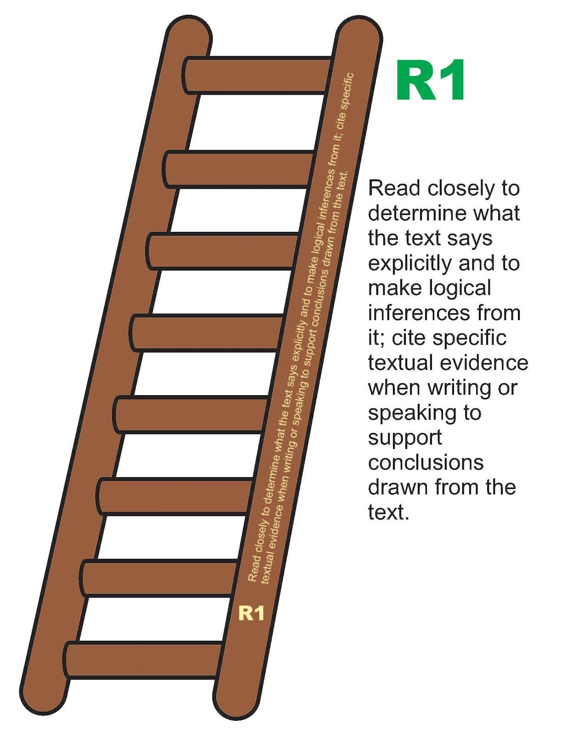
R1: Read closely

Slide 10
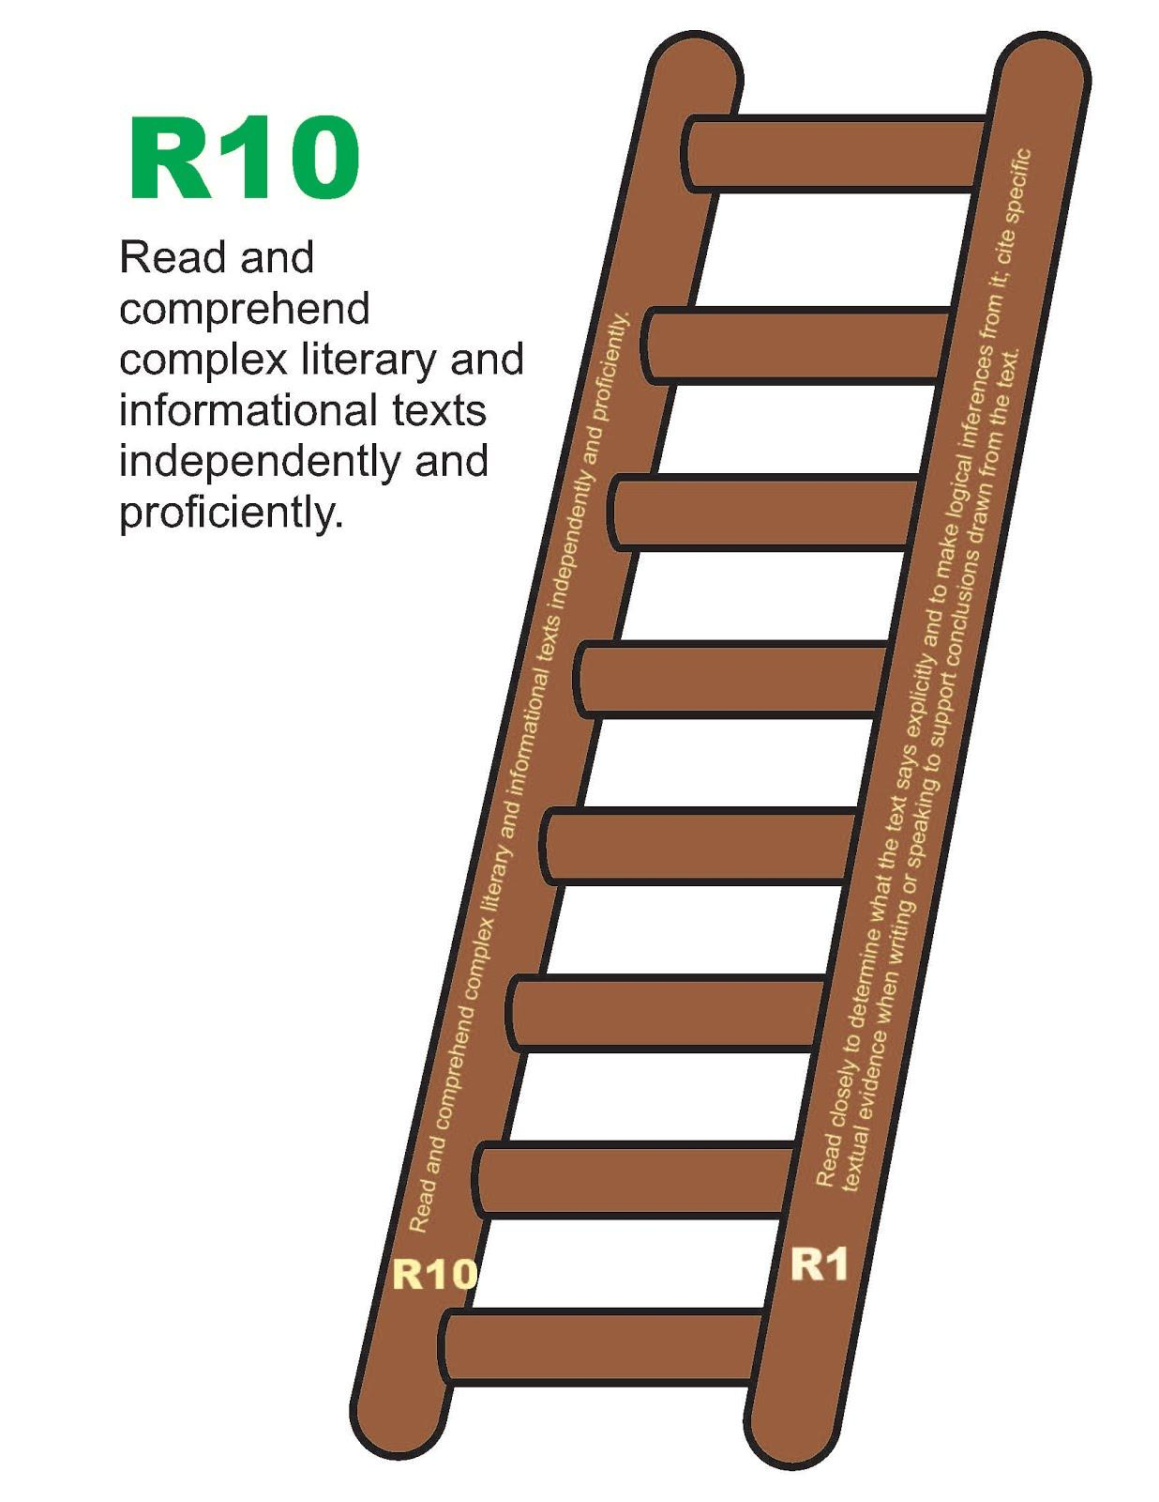
R10: Text Complexity

Slide 11
Six Shifts Video
https://www.youtube.com/watch?v=pkHSEWnUfnk

Slide 12
Six Pedagogical Shifts
Shifts in ELA/Literacy
Shift 1 | Balancing Informational and Literary Text | Students read a true balance of informational and literary texts.
Shift 2 | Knowledge in the Disciplines | Students build knowledge about the world (domains/ content areas through TEXT rather than the teacher or activities.
Shift 3 | Staircase of Complexity | Students read the central, grade appropriate text around which instruction is centered. Teachers are patient, create more time and space and support in the curriculum for close reading.
Shift 4 | Text-based answers | Students engage in rich and rigorous evidence based conversations about text.
Shift 5 | Writing from Sources | Writing emphasizes use of evidence from sources to inform or make an argument.
Shift 6 | Academic Vocabulary | Students constantly build the transferable vocabulary they need to access grade level complex texts. This can be done by spiraling like content in increasingly complex texts.

Slide 13
Six pedagogical shifts
Shifts in Mathematics
Shift 1 | Focus | Teachers significantly narrow and deepen the scope of how time and energy is spent in the mathematics classroom. They do so in order to focus deeply on only the concepts that are prioritized in the standards.
Shift 2 | Coherence | Principals and teachers carefully connect the learning within and across grades so that students can build new understanding onto foundations built in previous years.
Shift 3 | Fluency | Students are expected to have speed and accuracy with simple calculations; teachers structure class time and/ or homework time for students to memorize, through repetition, core functions.
Shift 4 | Deep Understanding | Students deeply understand and can operate easily within a math concept before moving on. They learn more than the trick to get the answer right. They learn the math.
Shift 5 | Application | Students are expected to use math and choose the appropriate concept for application even when they are not prompted to do so.
Shift 6 | Dual Intensity | Students are practicing and understanding. There is more than a balance between these two things in the classroom- both are occurring with intensity.

Slide 14
Questions to consider
In looking at the six pedagogical shifts, what commonalities do you notice? What key words stand out to you?

Slide 15
Circle the words that stand out in the shift…
Shifts in ELA/Literacy
Shift 1 | Balancing Informational and Literary Text | Students read a true balance of informational and literary texts.
Shift 2 | Knowledge in the Disciplines | Students build knowledge about the world (domains/ content areas through TEXT rather than the teacher or activities.
Shift 3 | Staircase of Complexity | Students read the central, grade appropriate text around which instruction is centered. Teachers are patient, create more time and space and support in the curriculum for close reading.
Shift 4 | Text-based answers | Students engage in rich and rigorous evidence based conversations about text.
Shift 5 | Writing from Sources | Writing emphasizes use of evidence from sources to inform or make an argument.
Shift 6 | Academic Vocabulary | Students constantly build the transferable vocabulary they need to access grade level complex texts. This can be done by spiraling like content in increasingly complex texts.

Slide 16
Circle the words that stand out in the shift…
Shifts in Mathematics
Shift 1 | Focus | Teachers significantly narrow and deepen the scope of how time and energy is spent in the mathematics classroom. They do so in order to focus deeply on only the concepts that are prioritized in the standards.
Shift 2 | Coherence | Principals and teachers carefully connect the learning within and across grades so that students can build new understanding onto foundations built in previous years.
Shift 3 | Fluency | Students are expected to have speed and accuracy with simple calculations; teachers structure class time and/ or homework time for students to memorize, through repetition, core functions.
Shift 4 | Deep Understanding | Students deeply understand and can operate easily within a math concept before moving on. They learn more than the trick to get the answer right. They learn the math.
Shift 5 | Application | Students are expected to use math and choose the appropriate concept for application even when they are not prompted to do so.
Shift 6 | Dual Intensity | Students are practicing and understanding. There is more than a balance between these two things in the classroom- both are occurring with intensity.

Slide 17
Literacy in the Disciplines
Disciplinary Literacy- Literacy Skills specialized to history, science, mathematics, literature, or some other subject (Shanahan and Shanahan, 2008) that leads to Deep Understanding, or comprehension that honors each discipline and is transferrable to different disciplines and to life

Slide 18
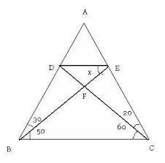
So reading like a mathematician, looks like….

Slide 19
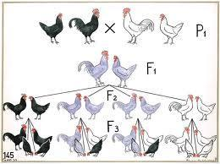
Reading Like a scientist may look like…

Slide 20
Reading like an art teacher may look like

Slide 21
What are our take aways?

Slide 22
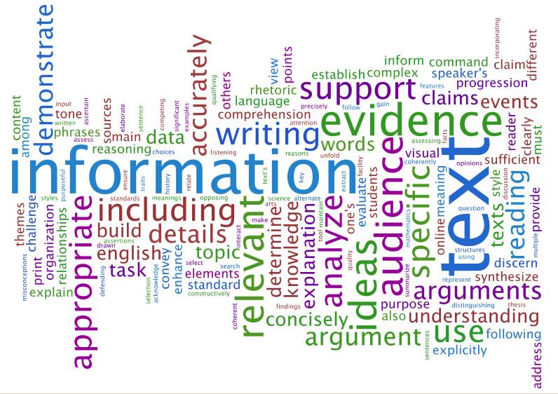
CCSS Wordle

