Slide 1
New Teacher Institute Orientation
Welcome to Harding University High School

Slide 2
Welcome to Harding University High School
Home of the RAMS
“We are RAM Tough!”

Slide 3
Introductions and Icebreaker

Slide 4
Handbook: Staff and Student Expectations
http://hardingrams.weebly.com/staff-handbook.html

Slide 5
PowerSchool, Canvas, and Email
https://idp.ncedcloud.org/idp/AuthnEngine#/authn

Slide 6
Student Services
http://hardingstudentservice.weebly.com/

Slide 7
Scavenger Hunt

Slide 8
Classroom Management

Slide 9
Student Presentation

Slide 10
Lunch

Slide 11
Capturing Kids Hearts

Slide 12
Parent Communication

Slide 13
ABCs of Teaching: Acronyms

Slide 14
PLCs and Planning
http://huhsplcs.weebly.com/

Slide 15
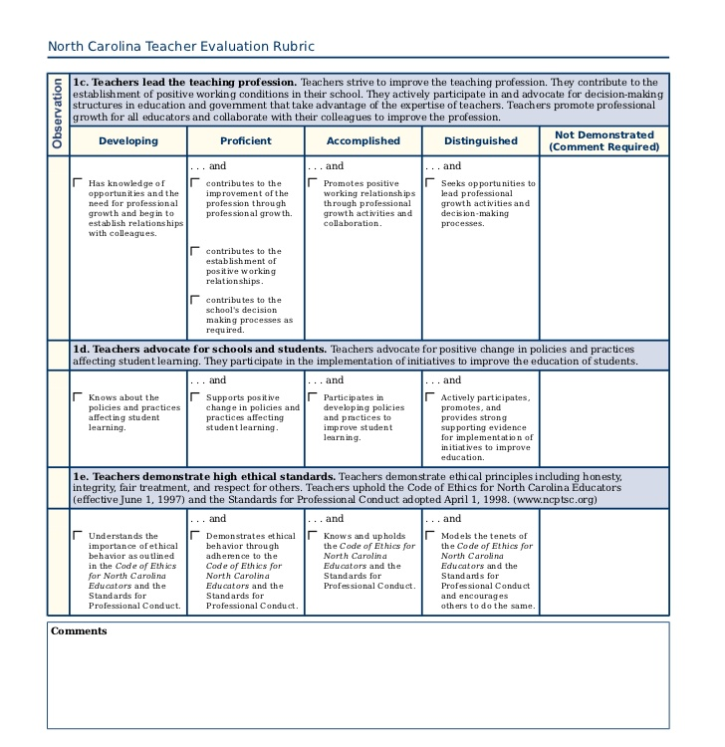
BTSP and Teacher Evaluation
https://cms.truenorthlogic.com/U/P/Channel/-/Guest/Login

Slide 16
Branding and Image

Slide 17
New Teacher Weebly
Access a multitude of resources specific to New Teachers
http://huhsnewteacher.weebly.com/

Slide 18
Thank You choosing HUHS!

