Slide 1
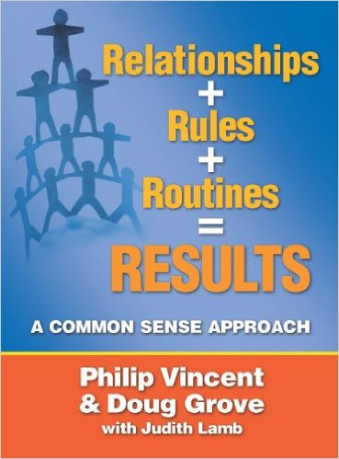
Book Study
HUHS New Teacher Institute

Slide 2
4 Foundational Ideas
1. Positive relationships with all stakeholders (combined with the development of)
2. Rules that act as expectations (and require us to develop)
3. Routines with the input of our students and other stakeholders (that yields)
4. Results in our school across the curriculum and other areas of the life of our school
Relationship + Rules + Routines = Results
(A Common Sense Formula)

Slide 3
Move Your Cheese!
What kind of climate do you want to work in?
Do you want to flourish as an educator?
Do you want your students to flourish?
How would you evaluate your current practices?
How might you change it up?
What are you assumptions?
What are your goals?

Slide 4
Create a Little Dis-Equilibrium
It is necessary in a child’s perception and experiences to foster growth
Requires us being appropriately challenged to re-think our assumptions
A school focused on the 4 Rs might enhance the academic, social, emotional, ethical and performance outcomes that result in greater opportunities for all stakeholders

Slide 5
Chapter 1 – Rethinking Our Assumptions

Slide 6
In Our Classrooms
No one is going to increase achievement with a single minded approach
Many dimensions or constructs will need to be considered
We need connectedness between people
We need a caring nurturing atmosphere
We need academic support and rigor working together
Consider and give attention to multiple variables that are predictive of success (habits, effort, kindness, respect, needs, parental involvement, support, motivation, safety, security, etc.)

Slide 7
We Are All Small Business Owners
Is the bottom line the only thing we need to look at?
How do we increase our profits?
Review page 6, give examples of other important factors.
How does this compare to a school?

Slide 8
Activity
Take 3-5 minutes to write out:
Tasks you consider foundational to improve the outcomes (academic, social, ethical, artistic, vocational, physical, etc.) of my students
One task we do as a school that I think has little to do with improving the outcomes of our students
After time is called, in groups of 4, share your views and make a list of priorities that you, as a group believe are foundational in improving student outcomes.
As a group, discuss what you think “Common sense is not common anymore.” means

Slide 9
Simply Put…..
The application of “Common Sense” that a caring, kind environment with consistent expectations and practices combined with support, encouragement and honest feedback matters and MATTERS GREATLY.
And combining that with good research and evaluation will help us become reflective practitioners which will give us the necessary tools to develop the best environment for all stakeholders.
Thus we will grow as practitioners and our students will grow (Academically and Personally)

Slide 10
Burning Questions
What does your heart and senses tell you, you should do to assist and help our students?”
Is there anything more important than developing a quality climate of sound relationships and established rules and routines so that all can flourish?

Slide 11
Charge and Homework….
Charge: Give your best and prioritize
Homework:
Write a letter to parents entitled: “What You Need to Do At Home to Assist Your Child” (Give at LEAST 5 practices in your letter)
In an effort to address other educators, list 5 practices or recommendations to other beginning teacher in regard to the topic: “Applying Common Sense to Education”

